Slide 1
Digital Portfolio
STUDENT NAME: S.HEMALATHA
REGISTER NO AND NMID: 212402481
DEPARTMENT: BCA
COLLEGE: AGURCHAND MANMULL JAIN COLLEGE

Slide 2
PROJECT TITLE
INTERACTIVE DIGITAL
PORTFOLIO USING
FRONT END
DEVELOPMENT

Slide 3


AGENDA
Problem Statement
Project Overview
End Users
Tools and Technologies
Portfolio design and Layout
Features and Functionality
Results and Screenshots
Conclusion
Github Link
3/21/2024 Annual Review

Slide 4

PROBLEM STATEMENT In today’s competitive digital landscape, individuals often struggle to effectively showcase their skills, projects, and professional achievements in a way that is both engaging and accessible. Traditional resumes and static portfolios fail to capture attention, provide limited interactivity, and lack personalization. This creates challenges for students, developers, designers, and professionals who want to stand out in academic, freelance, or job opportunities. There is a need for an interactive digital portfolio that leverages modern front-end development technologies to present personal branding, projects, and experiences in an appealing, user-friendly, and responsive manner. Such a solution should enable smooth navigation, dynamic content presentation, cross-device compatibility, and interactive elements that engage viewers while reflecting the creator’s technical and creative capabilities.

Slide 5

PROJECT OVERVIEW The Interactive Digital Portfolio is a web-based application designed to showcase an individual’s personal brand, skills, projects, and achievements through an engaging and user-friendly interface. Built using modern front-end technologies such as HTML, CSS, JavaScript, and frameworks/libraries like React.js or Vue.js, the portfolio aims to go beyond static resumes by providing a dynamic and interactive experience. The portfolio will include key sections such as: About Me – A brief introduction and professional background. Skills – Visual representation of technical and soft skills. Achievements & Certifications – Highlighting academic, professional, or personal milestones. Contact/Connect – Enabling direct communication through forms or integrated social links. The project emphasizes responsive design, ensuring seamless performance across desktops, tablets, and mobile devices. Additional features such as smooth animations, interactive UI components, and user-friendly navigation will be implemented to enhance engagement.

Slide 6

WHO ARE THE END USERS? 1. Primary End User – The Portfolio Owner Who they are: Students, job seekers, freelancers, developers, designers, or professionals who want to showcase their skills, projects, and achievements. What they need: A digital platform that highlights their strengths, creates a personal brand, and increases their chances of career opportunities. Benefit: They can present themselves in a professional, creative, and interactive way rather than relying on static resumes. 2. Secondary End Users – Viewers of the Portfolio Who they are: Recruiters, hiring managers, potential clients, academic evaluators, or collaborators. What they need: A quick, clear, and engaging way to evaluate the portfolio owner’s skills, creativity, and suitability for roles or projects.

Slide 7

TOOLS AND TECHNIQUES 1. Development Tools HTML5 – For structuring the portfolio content. CSS3 (with Flexbox/Grid) – For styling, layout design, and responsive UI. JavaScript (ES6+) – For interactivity, dynamic content, and smooth user experience. Frameworks/Libraries: React.js (or Angular/Vue.js) – To build reusable components and enhance interactivity. Bootstrap / Tailwind CSS – For responsive design and pre-styled UI components. Version Control: Git & GitHub – For source code management and deployment. Code Editor: Visual Studio Code (VS Code) – As the primary IDE with extensions for debugging and linting. 2. Design & Prototyping Tools Figma / Adobe XD / Canva – For UI/UX design and wireframing before coding. Color Palettes & Icon Libraries (Coolors, FontAwesome, Material Icons) – To create a visually appealing interface. 3. Techniques Responsive Web Design (RWD) – Ensuring the portfolio works seamlessly on desktops, tablets, and mobiles. Single Page Application (SPA) approach – Smooth navigation without reloading pages (if using React). Animations & Transitions – CSS animations, GSAP, or Framer Motion for engaging effects. Cross-Browser Compatibility – Testing on Chrome, Firefox, Edge, and Safari. Performance Optimization – Using image compression, code minification, and lazy loading. Deployment Techniques – Hosting via GitHub Pages, Netlify, or Vercel for free and reliable access.

Slide 8
POTFOLIO DESIGN AND LAYOUT
1. Development Tools
HTML5 – For structuring the portfolio content.
CSS3 (with Flexbox/Grid) – For styling, layout design, and responsive UI.
JavaScript (ES6+) – For interactivity, dynamic content, and smooth user experience.
Frameworks/Libraries:
React.js (or Angular/Vue.js) – To build reusable components and enhance interactivity.
Bootstrap / Tailwind CSS – For responsive design and pre-styled UI components.
Version Control:
Git & GitHub – For source code management and deployment.
Code Editor:
Visual Studio Code (VS Code) – As the primary IDE with extensions for debugging and linting.
2. Design & Prototyping Tools
Figma / Adobe XD / Canva – For UI/UX design and wireframing before coding.
Color Palettes & Icon Libraries (Coolors, FontAwesome, Material Icons) – To create a visually appealing interface.
3. Techniques
Responsive Web Design (RWD) – Ensuring the portfolio works seamlessly on desktops, tablets, and mobiles.
Single Page Application (SPA) approach – Smooth navigation without reloading pages (if using React).
Performance Optimization – Using image compression, code minification, and lazy loading.
Deployment Techniques – Hosting via GitHub Pages, Netlify, or Vercel for free and reliable access.
8

Slide 9
FEATURES AND FUNCTIONALITY 1. General Features Responsive Design – Works smoothly on desktop, tablet, and mobile. Single Page Navigation – Smooth scrolling or SPA-style navigation without full page reloads. Dark/Light Mode Toggle (optional) – Enhances personalization. Fast Loading & Optimized Media – Lazy loading for images, minified CSS/JS. 2. Home / Landing Page Animated intro text (fade-in, typewriter, or sliding effect). Call-to-Action Buttons – “Hire Me”, “Download Resume”, or “Explore Projects”. Smooth background animation (gradient, particles, or subtle shapes). 3. About Me Section Interactive profile card (flip or hover effects). Short bio with download resume option. Timeline view of education & career journey. 4. Skills Section Interactive Skill Representation: Progress bars, pie charts, or animated counters. Hover-over tooltips for skill levels. Categorized skills: Frontend, Tools, Soft Skills.

Slide 10
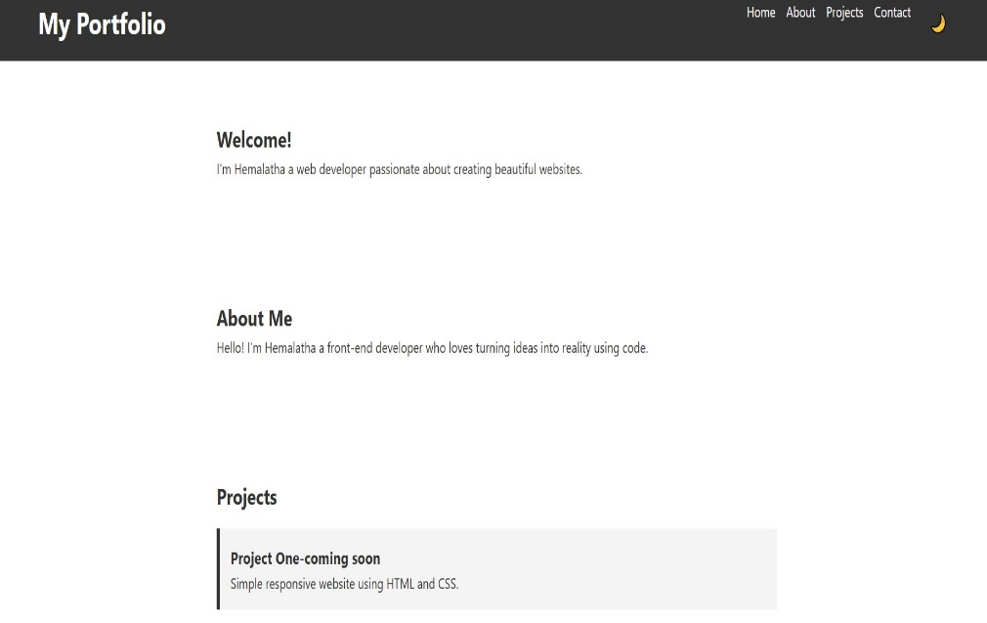

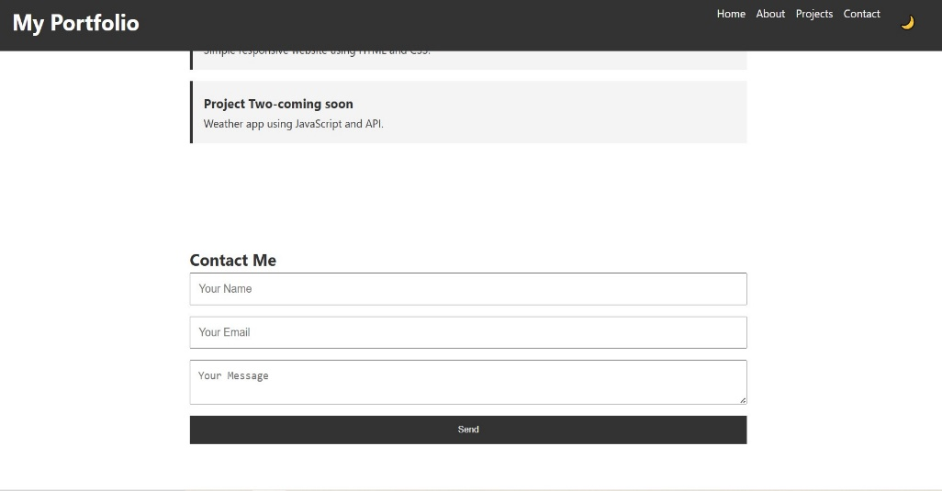
RESULTS AND SCREENSHOTS
3/21/2024 Annual Review
10

Slide 11
CONCLUSION The interactive digital portfolio developed using front-end technologies serves as a dynamic platform to showcase skills, projects, and personal achievements in a visually engaging manner. By integrating responsive design, intuitive navigation, and interactive features, it not only highlights the creator’s technical expertise but also enhances user experience. This project demonstrates the effective use of front-end development tools and techniques in building a professional, creative, and user-friendly portfolio that can leave a lasting impression on potential employers, clients, and collaborators.
11

